Slide 1
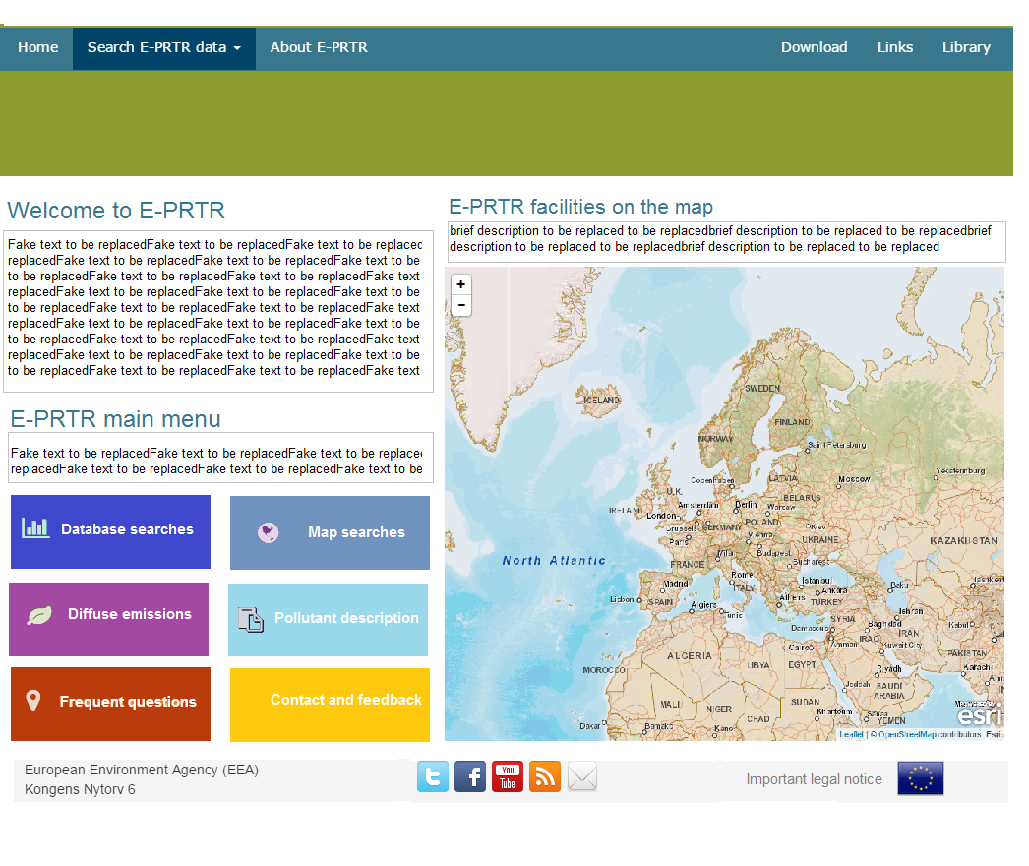



Library to be discontinued? – content now accessible via buttons
Agency’s logo is under scrutiny – when finished we’ll supply it
EC’s logo according to DG ENV’s indications
Please add this image provided by EEA COM department to improve layout
Button to be replaced by ‘E-PRTR Library’ and contain the information of http://prtr.ec.europa.eu/pgLibraryActivities.aspx
http://prtr.ec.europa.eu/pgLibraryGlossary.aspx
http://prtr.ec.europa.eu/pgLibraryWaste.aspx
Suggest to revamp text to make it very brief and link to PDF files with detailed information
Original content will be transfered as agreed in telecon
This button will enable access, with an ad hoc solution, to all the search options that remain in the future website
This button will give access to both the current materials on AIR and the new materials to be integrated by Atkins on WATER

